Slide 1
Data Analysis & Visualization — Introduction to Data and Visualization Tools—
By Dr. Harriet Sibitenda

Slide 2
Introduction
Data analysis is the process of extracting insights and meaning from data by analyzing and interpreting it. In today's world, data is abundant, and data analytics is becoming increasingly important across various fields, including business, healthcare, education, and many others. If you are a beginner in data analytics, this guide will help you get started.
The data can be of different types, including structured, unstructured, and semi-structured. Structured data is organized and easily searchable, like data in a spreadsheet. Unstructured data, like text or images, is not easily searchable, and semi-structured data is a combination of both.
Some of the commonly used data analysis techniques include descriptive analysis, predictive analysis, and prescriptive analysis.

Slide 3
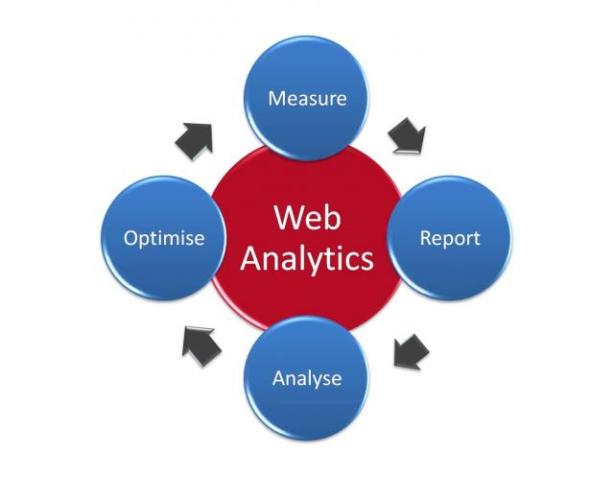
Data Analysis tools
To analyze data, you need to use tools that can help you process and manipulate data. Some of the commonly used data analytics tools include Excel, R, Python, SQL, Tableau, and Power BI. Excel is a widely used tool for data analytics, and it is easy to use, especially for beginners. R and Python are programming languages that are commonly used for data analytics. SQL is a language used to query databases, and Tableau and Power BI are tools used for data visualization.

Slide 4
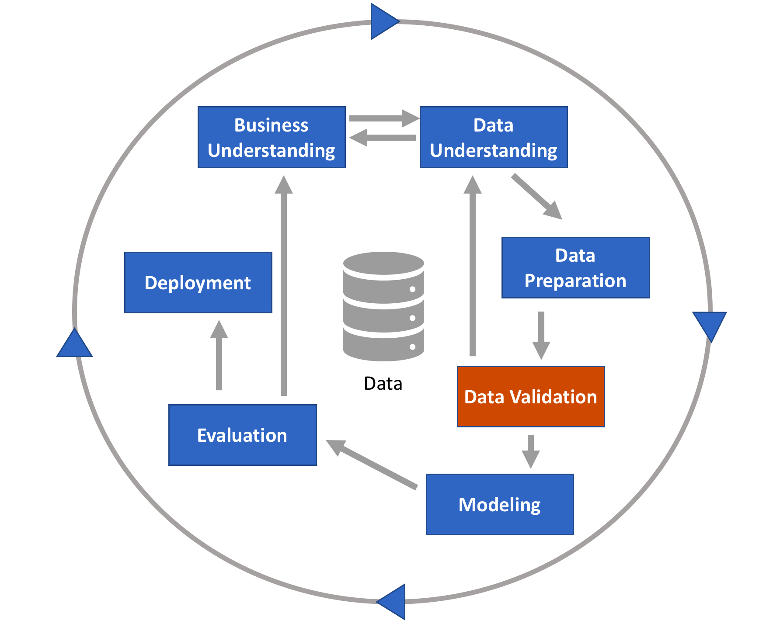
Data Preparation
Before you start analyzing data, you need to prepare it. Data preparation involves cleaning, transforming, and organizing data. Cleaning data involves removing or fixing errors, like missing values or incorrect data. Transforming data involves converting data from one form to another, like converting a text field to a numerical field. Organizing data involves structuring the data in a way that makes it easy to analyze.

Slide 5
Data Visualization
Machine Learning
Data visualization involves representing data using charts, graphs, and other visual tools. Data visualization is important because it helps you understand and communicate insights and meaning from the data. Some of the commonly used data visualization tools include Tableau, Power BI, and Excel. When creating visualizations, it is important to choose the right type of chart or graph that can best represent the data
Machine learning is a subfield of data analytics that involves using algorithms to make predictions and decisions based on data. Machine learning algorithms can be used for tasks like image recognition, language translation, and fraud detection. Some of the commonly used machine learning algorithms include linear regression, logistic regression, and decision trees.

Slide 6
Data Visualization: What is it?
Data visualization is the graphical representation of information and data.
By using visual elements like charts, graphs, and maps, data visualization tools provide an accessible way to see and understand trends, outliers, and patterns in data.
It provides an excellent way for employees or business owners to present data to non-technical audiences without confusion.
Helps too make decisions and use visuals to tell stories of when data informs the who, what, when, where, and how.
While traditional education typically draws a distinct line between creative storytelling and technical analysis, the modern professional world also values those who can cross between the two:
data visualization sits right in the middle of analysis and visual storytelling.
A good visualization tells a story, removing the noise from data and highlighting useful information.

Slide 7
General Types of Visualizations
Chart: Information presented in a tabular, graphical form with data displayed along two axes. Can be in the form of a graph, diagram, or map.
Table: A set of figures displayed in rows and columns.
Graph: A diagram of points, lines, segments, curves, or areas that represents certain variables in comparison to each other, usually along two axes at a right angle.
Geospatial: A visualization that shows data in map form using different shapes and colors to show the relationship between pieces of data and specific locations.
Infographic: A combination of visuals and words that represent data. Usually uses charts or diagrams.
Dashboards: A collection of visualizations and data displayed in one place to help with analyzing and presenting data.

Slide 8
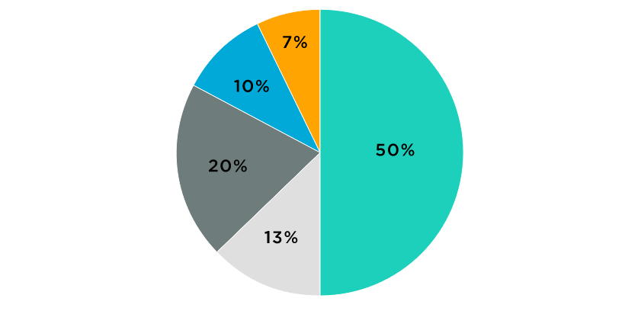
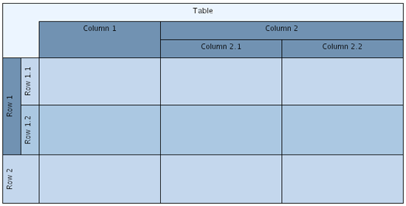
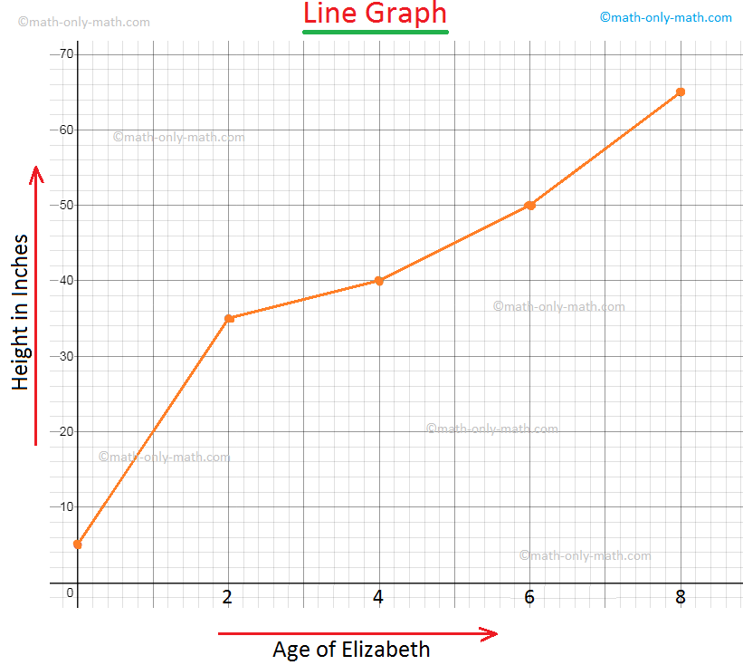

Pie Chart
Table
Graph
Geospatial Graph

Slide 9
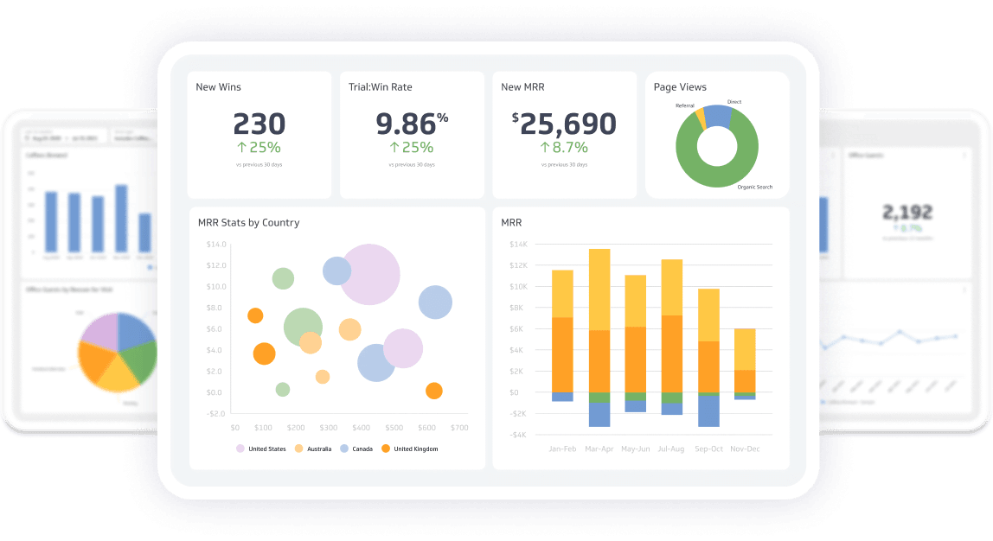
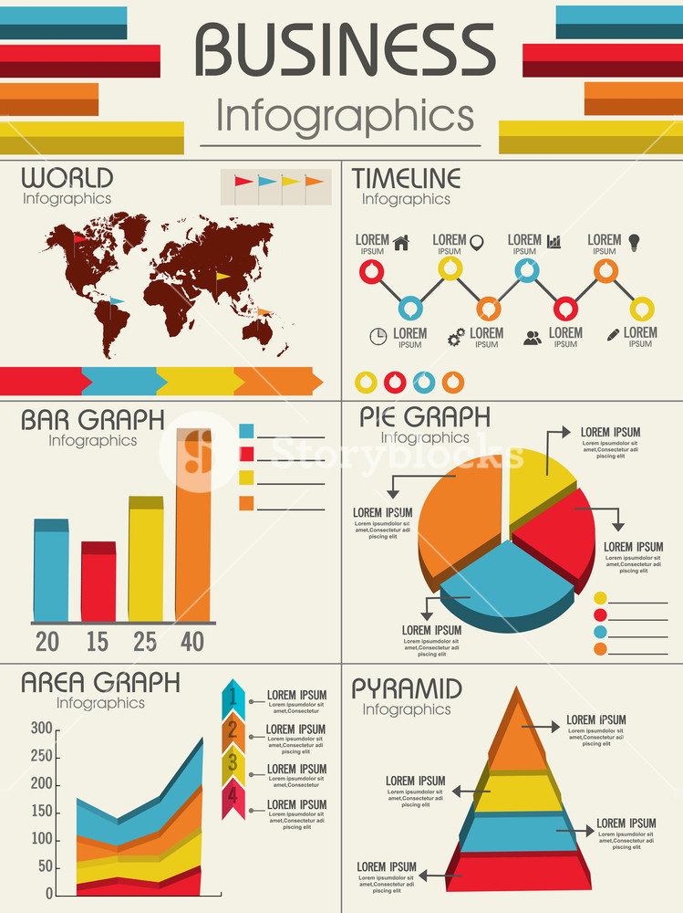

Slide 10
Specific Examples:
Area Map: A form of geospatial visualization, used to show specific values set over a map of a country, state, any location.
Bar Chart: Bar charts represent numerical values compared to each other.
Box-and-whisker Plots: These show a selection of ranges (the box) across a set measure (the bar).
Bullet Graph: A bar marked against a background to show progress against a goal, denoted by a line on the graph.
Gantt Chart: Typically used in project management, Gantt charts are a bar chart depiction of timelines and tasks.
Heat Map: A type of geospatial visualization in map form which displays specific data values as different colors.
Highlight Table: A form of table that uses color to categorize similar data, allowing the viewer to read it more easily.
Histogram: A type of bar chart that split a continuous measure into different bins to help analyze the distribution.
Pie Chart: A circular chart with triangular segments that shows data as a percentage of a whole.
Treemap: A type of chart that shows different, related values in the form of rectangles nested together.

Slide 11
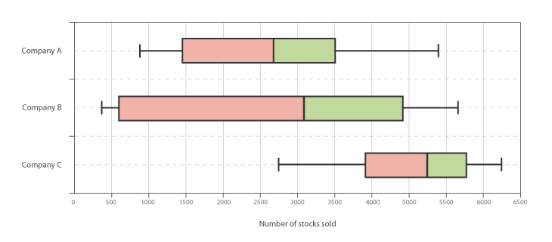
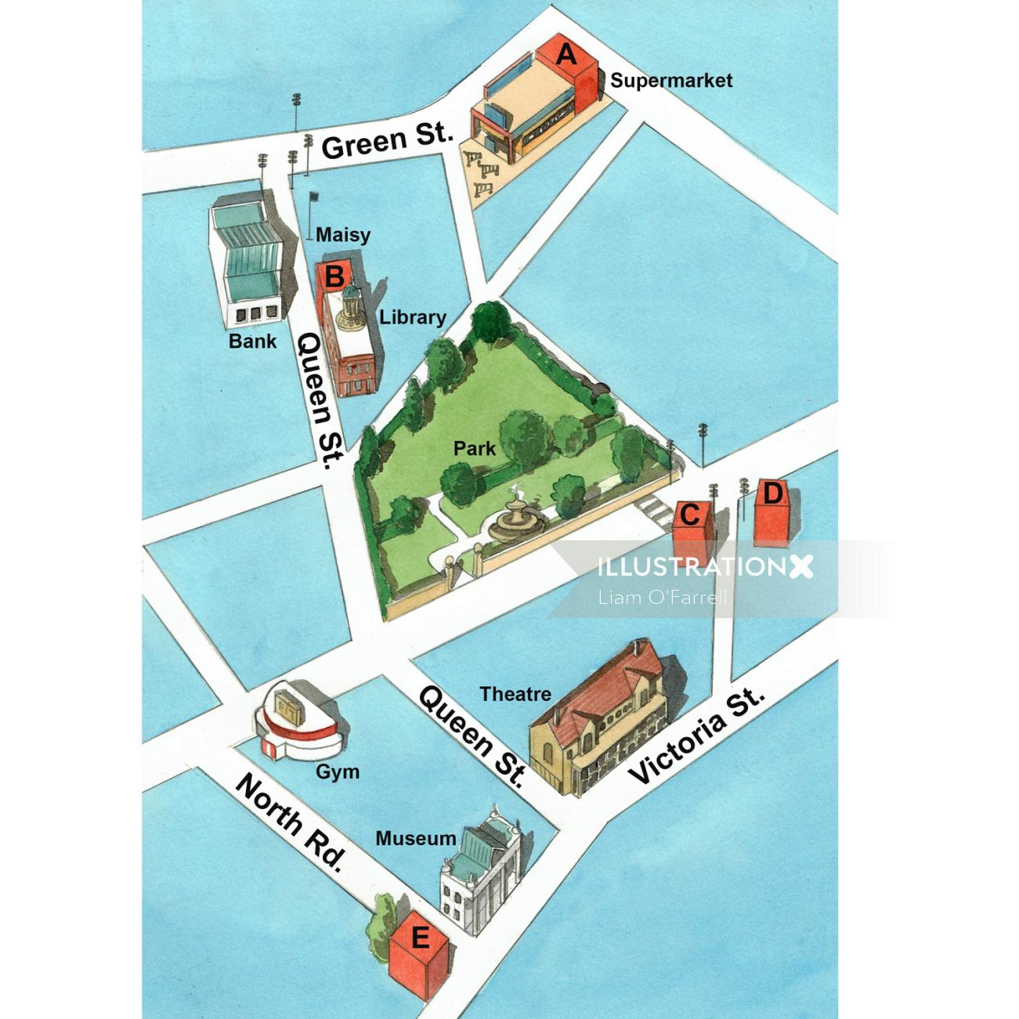
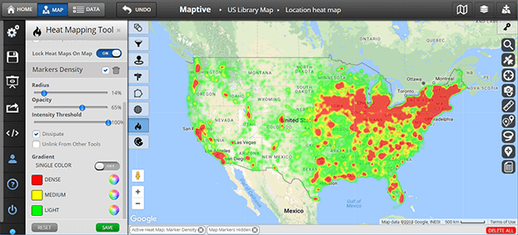
Box & Whisker Plot

Slide 12
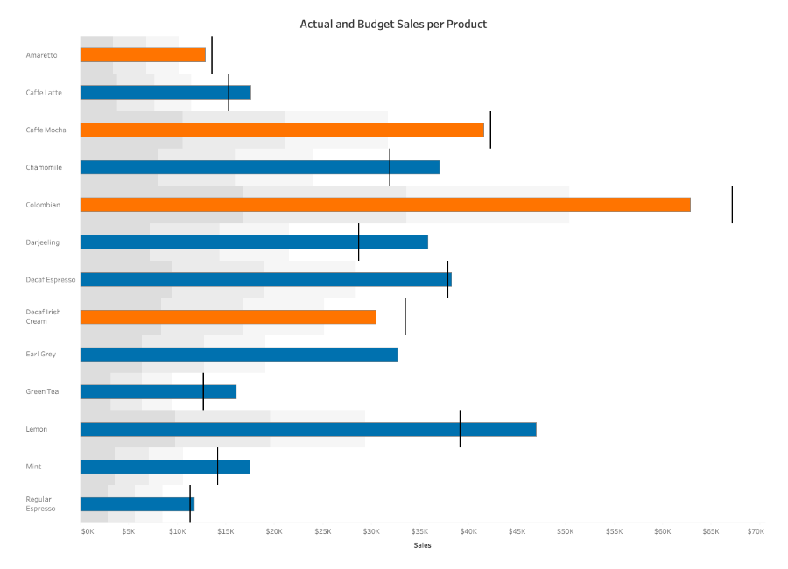
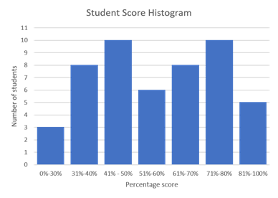
Bullet Graph

Slide 13
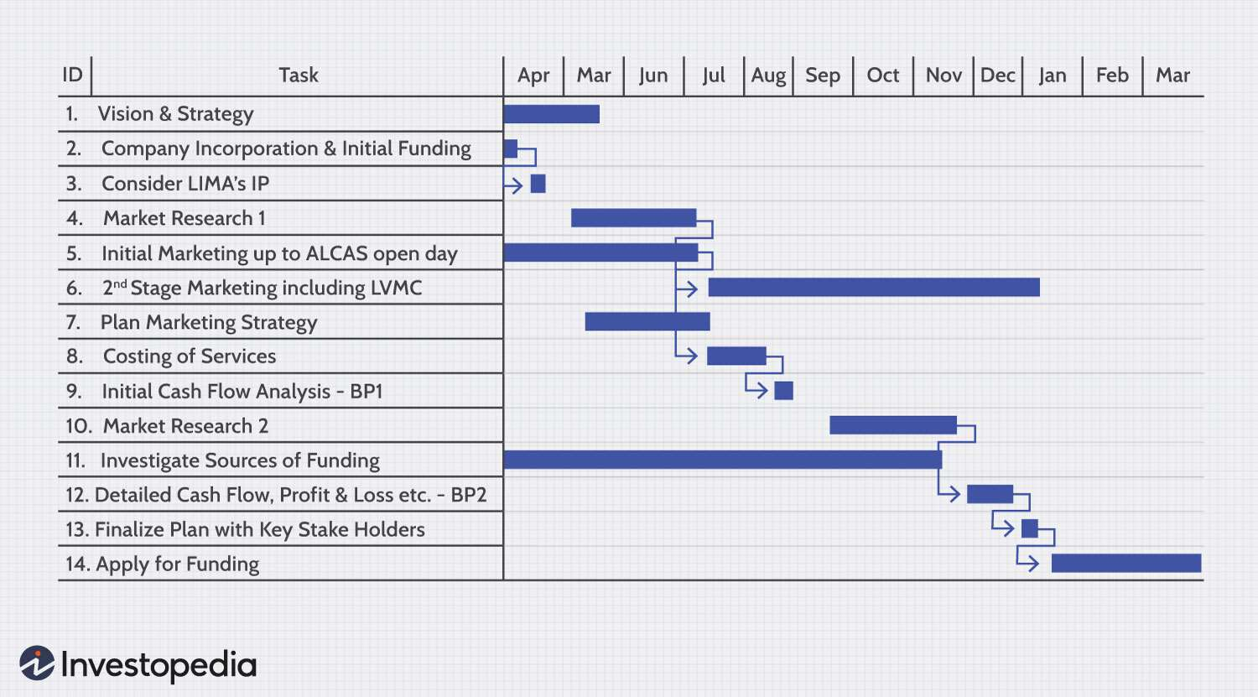
Gantt Chart

Slide 14
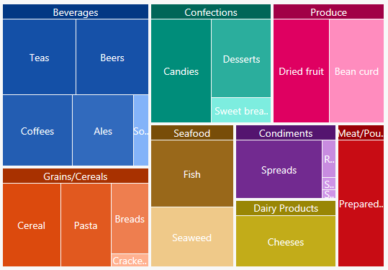

Slide 15
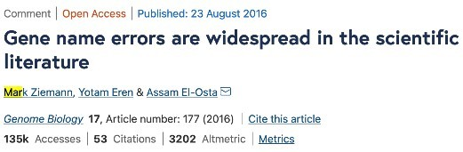
Problem with “just” using Excel
Limited rows
Slow in opening large files
Cannot streamline “pipe” input & output from and to other processing
Often we just need one line of command to finish
E.g. `cat XXX.gtf | awk '$3=="gene"'| cut -f9 | sed 's/.*gene_id=\([^;]*\)*.*/\1/g' | sort -u`
extracts unique gene IDs from the entire GTF annotation
On Excel, you may need many clicks and “save as" and open for the same action
Less versatile processing functions
May inadvertently have data changed automatically by Excel formatting
e.g. “gene symbols such as SEPT2 (Septin 2) and
MARCH1 [Membrane-Associated Ring Finger (C3HC4) 1,
E3 Ubiquitin Protein Ligase] are converted by default to ‘2-Sep’ and ‘1-Mar’”
https://genomebiology.biomedcentral.co m/articles/10.1186/s13059-016-1044-7
9

Slide 16
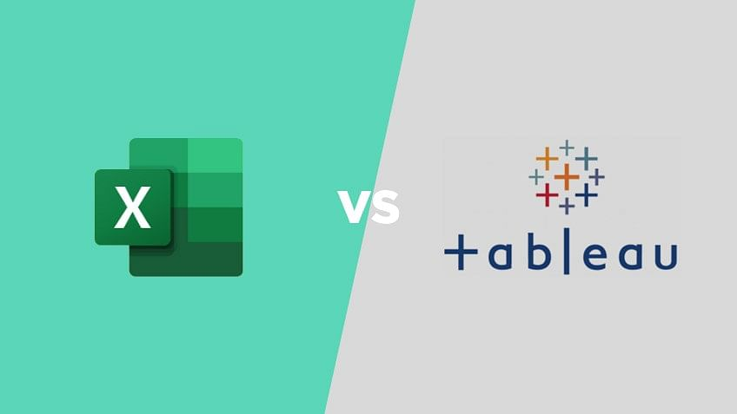
Excel VS Tableau
Microsoft Excel is a spreadsheet application used for calculations, statistical operations, data analysis, and reporting.
Tableau is a business intelligence and data visualization tool to get insights from data, find hidden trends, and make business decisions.
Excel works well when we have to create quick, one-off reports.
Tableau is helpful when we want a more detailed analysis of your business reports.

Slide 17

Tableau Download
https://www.tableau.com/academic/students

Slide 18
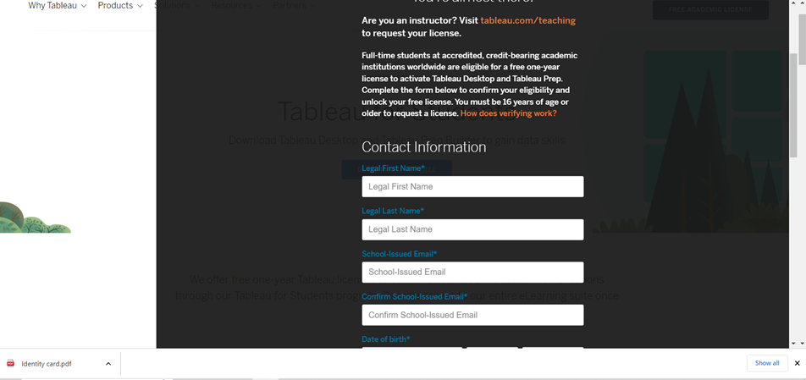
Fill in all the details & also keep a soft copy of your college Identity card ready

Slide 19

Once you receive the key go the site and download in your laptop (use the key provided in ur college email id )

Slide 20
Data Analysis and Visaulisation with ML
A branch of artificial intelligence, concerned with the design and development of algorithms that allow computers to evolve behaviors based on empirical data.
As intelligence requires knowledge, it is necessary for the computers to acquire knowledge.

Slide 21
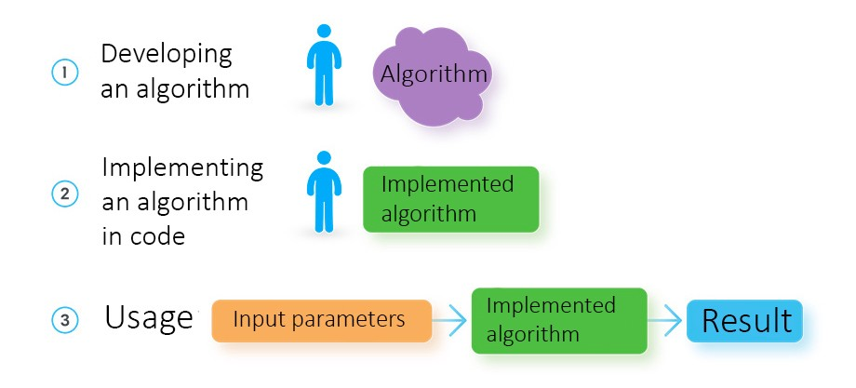
How a software developer creates a solution

Slide 22
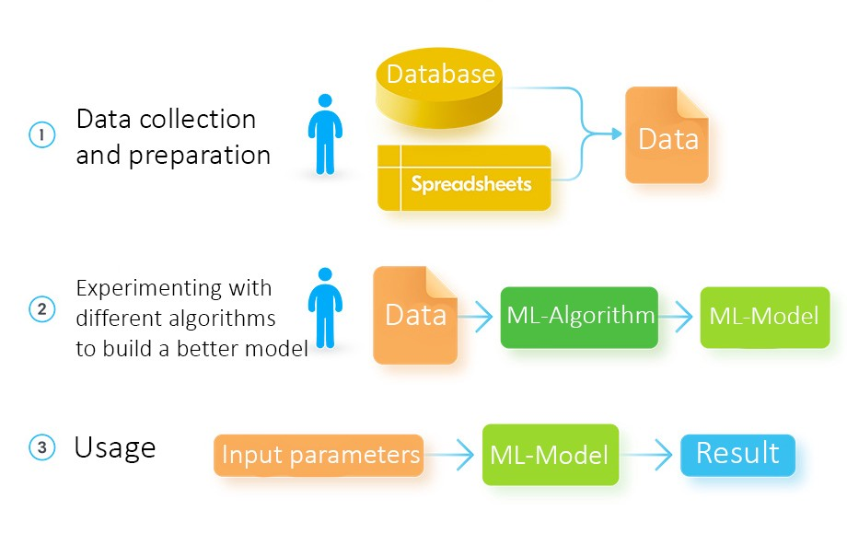
How a data engineer develops a solution using machine learning

Slide 23
What is Machine Learning?
Aspect of AI: creates knowledge
Definition:
“changes in [a] system that ... enable [it] to do the same task or tasks drawn from the same population more efficiently and more effectively the next time.'' (Simon 1983)
There are two ways that a system can improve:
1. By acquiring new knowledge
acquiring new facts
acquiring new skills
2. By adapting its behavior
solving problems more accurately
solving problems more efficiently

Slide 24
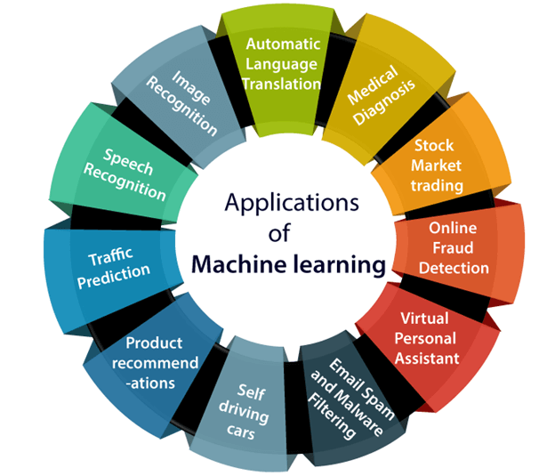
Applications of Machine learning
Machine learning is a buzzword for today's technology, and it is growing very rapidly day by day.
We are using machine learning in our daily life even without knowing it such as Google Maps, Google assistant, Alexa, etc.

Slide 25

Real-World Applications
With the rise in big data, machine learning has become particularly important for solving problems in areas like these:
Computational finance, for credit scoring and algorithmic trading
Image processing and computer vision, for face recognition, motion detection, and object detection
Computational biology, for tumor detection, drug discovery, and DNA sequencing
Energy production, for price and load forecasting
Automotive, aerospace, and manufacturing, for predictive maintenance
Natural language processing

Slide 26
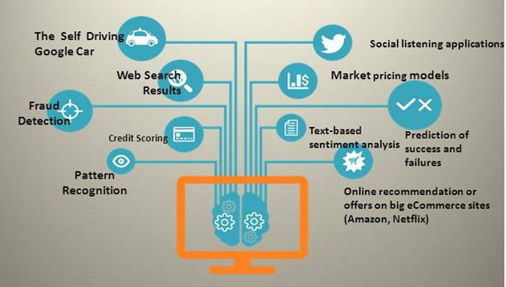
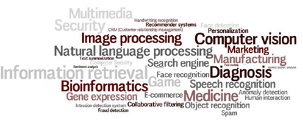
Machine Learning Trends

Slide 27

Machine Learning Trends
“Telephone took 75 years to reach 50 million users, radio 38 yrs, television 13 yrs, Internet 4 yrs, Facebook 19 months, Pokemon Go 19 days. AarogyaSetu, India’s app to fight COVID-19 has reached 50 mn users in just 13 days-fastest ever globally for an App,” Kant said in his tweet.
The app will calculate this based on their interaction with others, using cutting edge Bluetooth technology, algorithms and artificial intelligence.

Slide 28
What Machine Learning can do
Finding which category an object belongs to -- by Classification Algorithm
Finding what is strange -- by Anomaly Detection Algorithm
Finding how much and how many -- by Regression Algorithm
Finding how data is arranged – by Clustering Algorithm
What should I do next -- by Reinforcement Algorithm

Slide 29
History of Machine Learning
1960’s and 70’s: Models of human learning
High-level symbolic descriptions of knowledge, e.g., logical expressions or graphs/networks, e.g., (Karpinski & Michalski, 1966) (Simon & Lea, 1974).
Winston’s (1975) structural learning system learned logic-based structural descriptions from examples.
Minsky Papert, 1969
1970’s: Genetic algorithms
Developed by Holland (1975)
1970’s - present: Knowledge-intensive learning
A tabula rasa approach typically fares poorly. “To acquire new knowledge a system must already possess a great deal of initial knowledge.” Lenat’s CYC project is a good example.

Slide 30
History of Machine Learning (cont’d)
1970’s - present: Alternative modes of learning (besides examples)
Learning from instruction, e.g., (Mostow, 1983) (Gordon & Subramanian, 1993)
Learning by analogy, e.g., (Veloso, 1990)
Learning from cases, e.g., (Aha, 1991)
Discovery (Lenat, 1977)
1991: The first of a series of workshops on Multistrategy Learning (Michalski)
1970’s – present: Meta-learning
Heuristics for focusing attention, e.g., (Gordon & Subramanian, 1996)
Active selection of examples for learning, e.g., (Angluin, 1987), (Gasarch & Smith, 1988), (Gordon, 1991)
Learning how to learn, e.g., (Schmidhuber, 1996)

Slide 31
History of Machine Learning (cont’d)
1980 – The First Machine Learning Workshop was held at Carnegie-Mellon University in Pittsburgh.
1980 – Three consecutive issues of the International Journal of Policy Analysis and Information Systems were specially devoted to machine learning.
1981 - Hinton, Jordan, Sejnowski, Rumelhart, McLeland at UCSD
Back Propagation alg. PDP Book
1986 – The establishment of the Machine Learning journal.
1987 – The beginning of annual international conferences on machine learning (ICML). Snowbird ML conference
1988 – The beginning of regular workshops on computational learning theory (COLT).
1990’s – Explosive growth in the field of data mining, which involves the application of machine learning techniques.

Slide 32
Bottom line from History
1960 – The Perceptron (Minsky Papert)
1960 – “Bellman Curse of Dimensionality”
1980 – Bounds on statistical estimators (C. Stone)
1990 – Beginning of high dimensional data (Hundreds variables)
2000 – High dimensional data (Thousands variables)

Slide 33
How Do You Decide Which Algorithm to Use?
Choosing the right algorithm can seem overwhelming—there are dozens of supervised and unsupervised machine learning algorithms, and each takes a different approach to learning.
There is no best method or one size fits all. Finding the right algorithm is partly just trial and error—even highly experienced data scientists can’t tell whether an algorithm will work without trying it out.
But algorithm selection also depends on the size and type of data you’re working with, the insights you want to get from the data, and how those insights will be used.

Slide 34
Questions to Consider Before You Start
Every machine learning workflow begins with three questions:
What kind of data are you working with?
What insights do you want to get from it?
How and where will those insights be applied?
Your answers to these questions help you decide whether to use supervised or unsupervised learning.

Slide 35
Designing a Learning System
Choose the training experience
Choose exactly what is too be learned, i.e. the target function.
Choose how to represent the target function.
Choose a learning algorithm to infer the target function from the experience.
Learner
Environment/
Experience
Knowledge
Performance
Element

Slide 36
Learning Paradigms
Supervised learning
Generates a function that maps inputs to desired outputs.
For example, in a classification problem, the learner approximates a function mapping a vector into classes by looking at input-output examples of the function
Probably, the most common paradigm
E.g., decision trees, support vector machines, Naïve Bayes, k-Nearest Neighbors, …

Slide 37
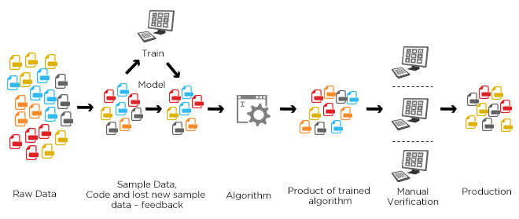
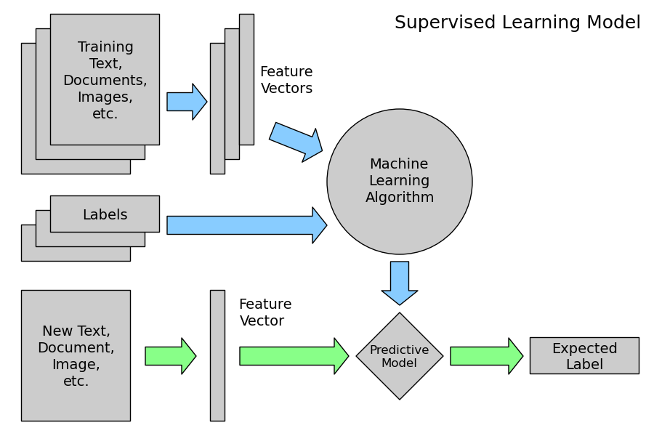
Machine learning structure
Supervised learning

Slide 38
Learning Paradigms
Unsupervised learning
Labels are not known during training
E.g., clustering, association learning
Semi-supervised learning
Combines both labeled and unlabeled examples to generate an appropriate function or classifier
E.g., Transductive Support Vector Machine

Slide 39
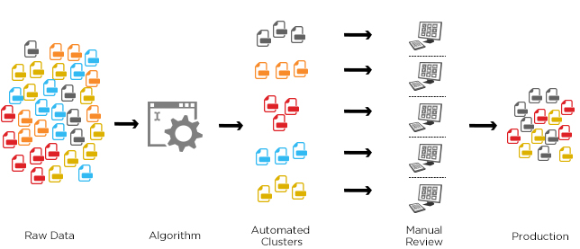
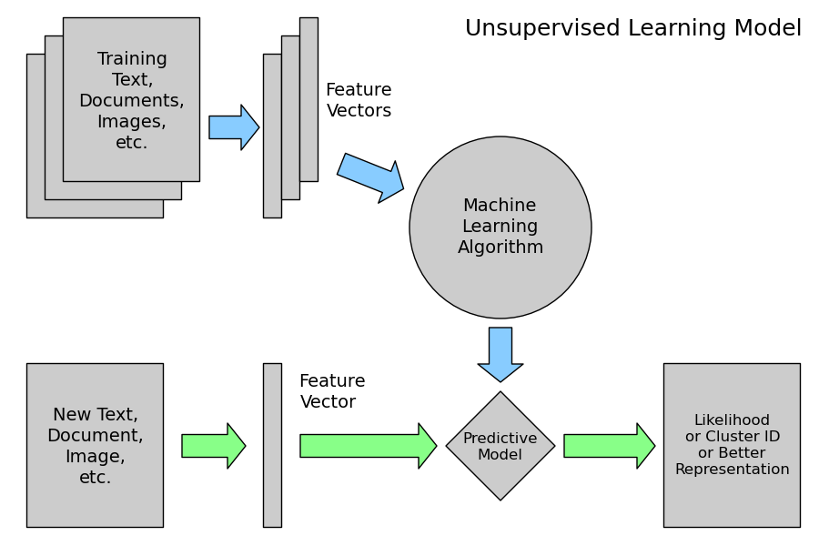
Machine learning structure
Unsupervised learning

Slide 40
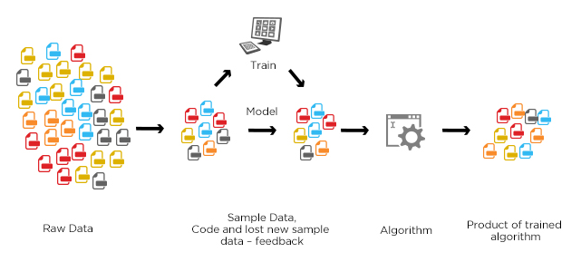
Machine learning structure
semisupervised learning
The goal of a semi-supervised model is to classify some of the unlabeled data using the labeled information set.
Speech Analysis
Protein Sequencing
Web content analysis
Notes:
Auto text expander

Slide 41
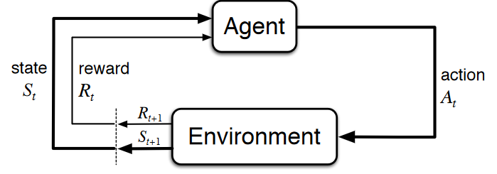
Reinforcement Learning
In the absence of training dataset, it is bound to learn from its experience.
We have an agent and a reward, with many hurdles in between. The agent is supposed to find the best possible path to reach the reward.
Types of Reinforcement: positive, negative, punishment, and extinction.

Slide 42
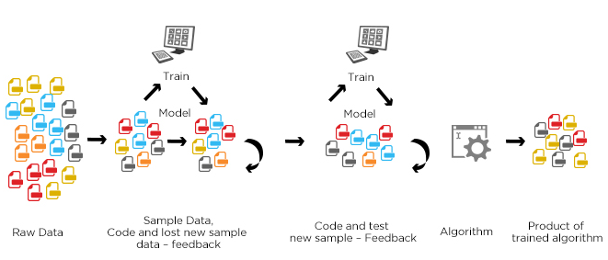
Machine learning structure
Reinforcement learning
It is concerned with how an agent should take actions in an environment so as to maximize some notion of cumulative reward.
Reward given if some evaluation metric improved
Punishment in the reverse case
E.g., Q-learning, Sarsa

Slide 43
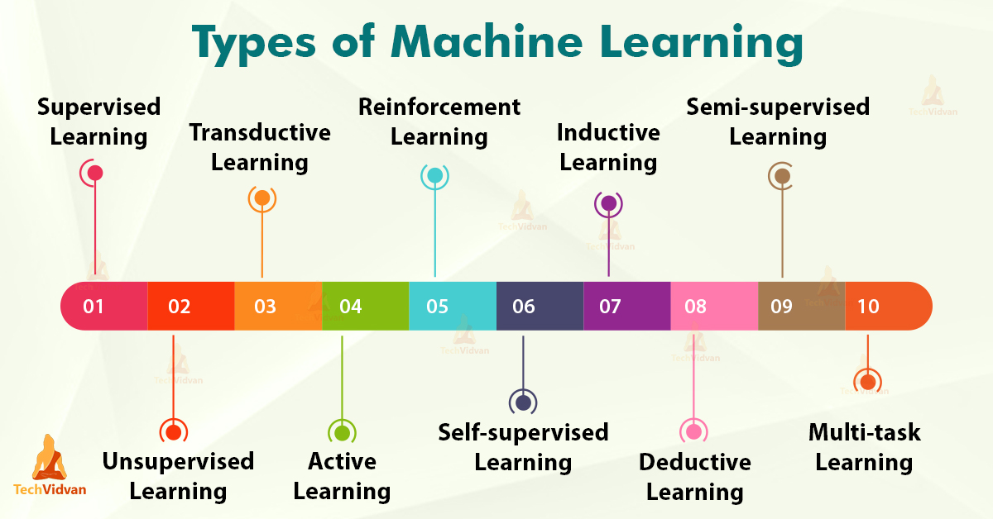

Slide 44
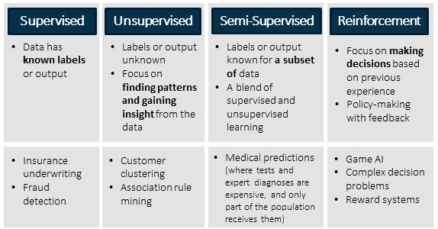
Major Types of Learning

Slide 45
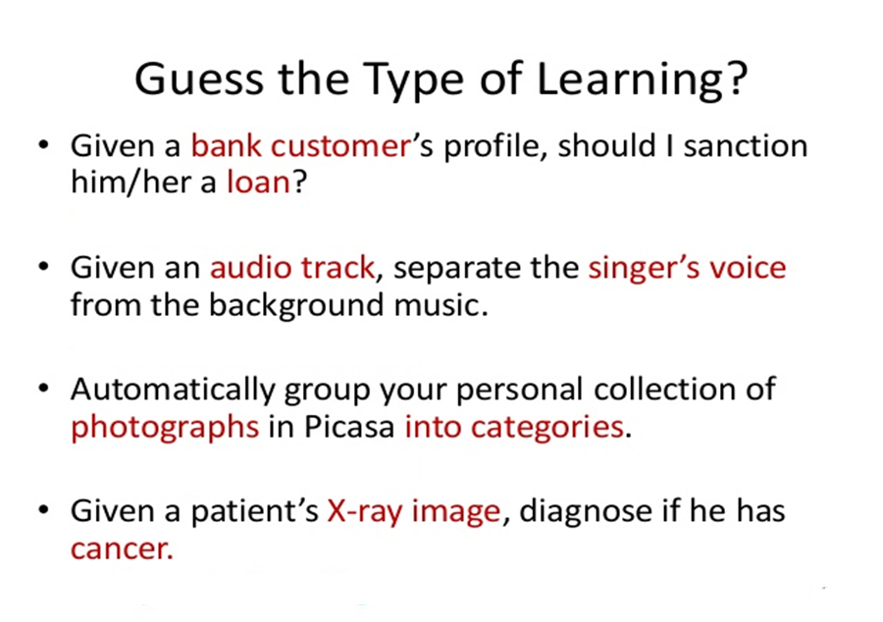

Slide 46
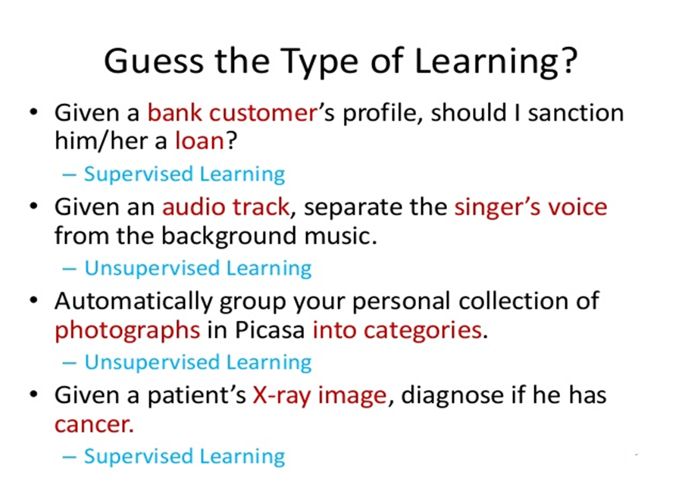

Slide 47
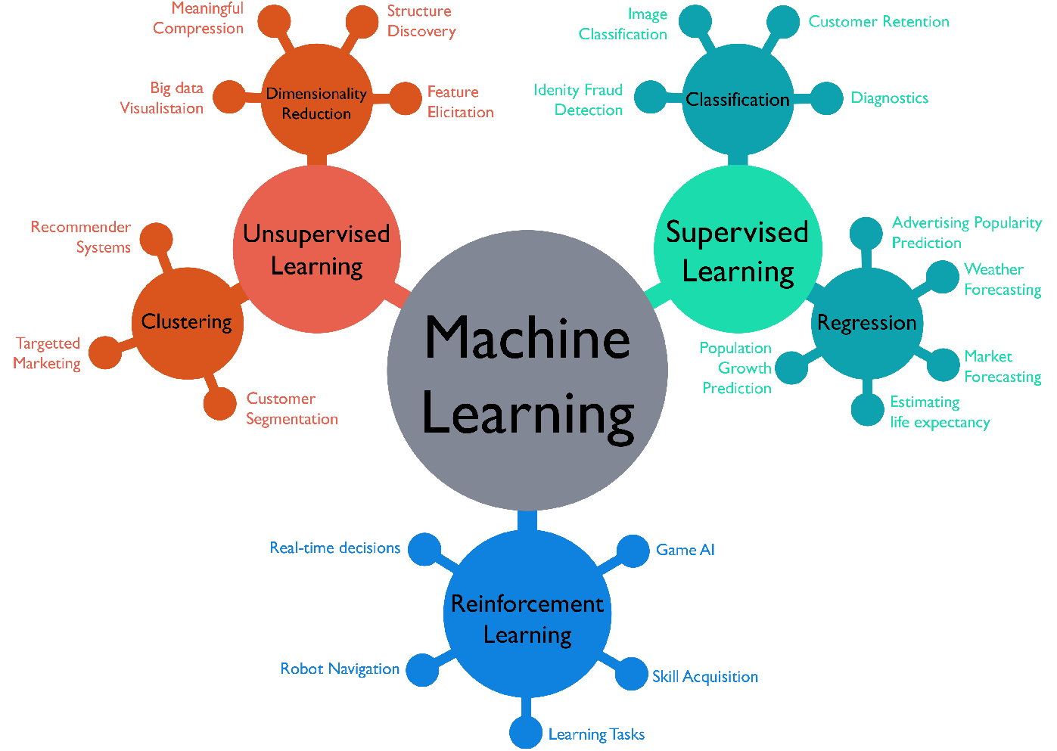
Machine Learning Perspectives

Slide 48
Algorithms
Supervised learning
Prediction
Classification (discrete labels), Regression (real values)
Unsupervised learning
Clustering
Probability distribution estimation
Finding association (in features)
Dimension reduction
Semi-supervised learning
Reinforcement learning
Decision making (robot, chess machine)

Slide 49
ML Algorithms
Classification
Learn a way to classify unseen examples, based on a set of labeled examples, e.g., classify songs by emotion categories. E.g., decision trees (e.g., C5.4)
Regression
Learn a way to predict continuous output values, based on a set of labeled examples, e.g., predict software development effort in person months
Sometimes regarded as numeric classification (outputs are continuous instead of discrete)
E.g., Support Vector Regression

Slide 50
ML Algorithms
Association
Find any association among features, not just input-output associations (e.g., in a supermarket, find that clients who buys apples also buys cereals)
E.g., Apriori
Clustering
Find natural grouping among data
E.g., K-means clustering, DBSCAN, Heirarchial clustering

Slide 51
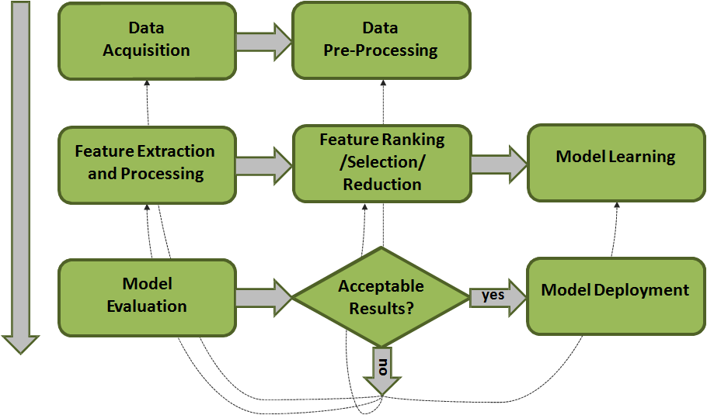
Machine Learning Process

Slide 52
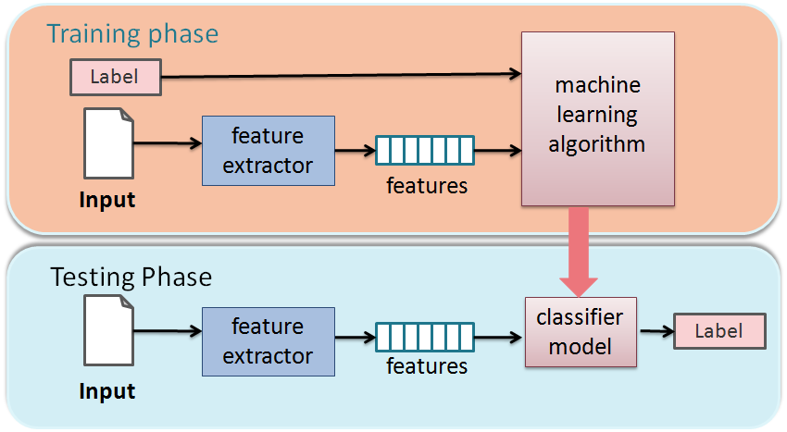
Training and testing
Training is the process of making the system able to learn.
No free lunch rule:
Training set and testing set come from the same distribution
Need to make some assumptions or bias

Slide 53
Performance
There are several factors affecting the performance:
Types of training provided
The form and extent of any initial background knowledge
The type of feedback provided
The learning algorithms used
Two important factors:
Modeling
Optimization

Slide 54
Machine Learning Traditions
Different ML traditions propose different approaches inspired by real-world analogies
Neural networks researchers: emphasize analogies to neurobiology
Case-based learning: human memory
Genetic algorithms: evolution
Rule induction: heuristic search
Analytic methods: reasoning in formal logic
Again, different notation and terminology

Slide 55
Different Varieties of Machine Learning
Concept Learning
Clustering Algorithms
Connectionist Algorithms
Genetic Algorithms
Explanation-based Learning
Transformation-based Learning
Reinforcement Learning
Case-based Learning
Macro Learning
Evaluation Functions
Cognitive Learning Architectures
Constructive Induction
Discovery Systems
Knowledge capture

Slide 56
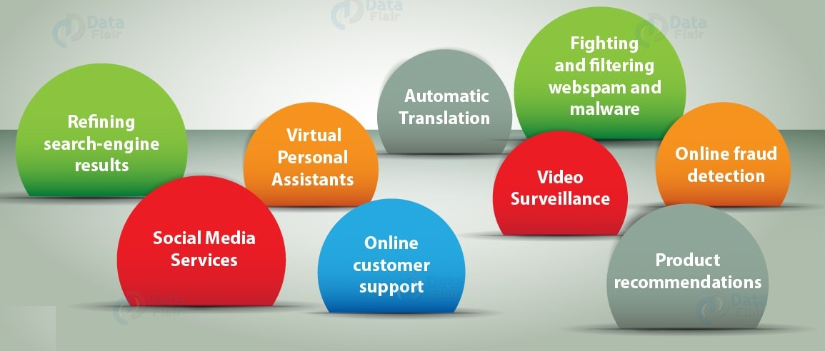
Machine Learning Applications

Slide 57
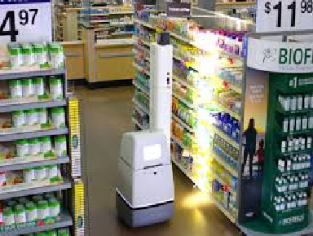
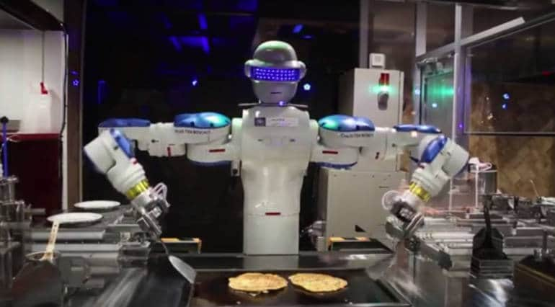

Machine Learning touching our Daily Life
Walmart use Robots in their stores for inventory management, packing, pricing checks
Restaurants have Robot chefs and Waiters

Slide 58
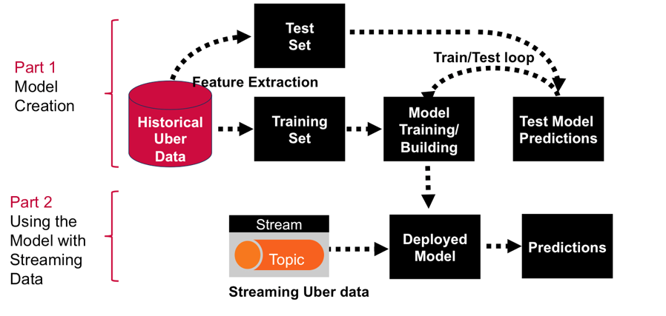

Machine Learning touching our Daily Life
Michelangelo, an internal ML-as-a-service platform that democratizes machine learning and makes scaling AI to meet the needs of business as easy as requesting a ride.

Slide 59



Machine Learning touching our Daily Life
Song Recommendations based on mood and interest
Data Acquisition from Tamr – Enterprise Data Unification Company
Content specific vaccines for Children

Slide 60

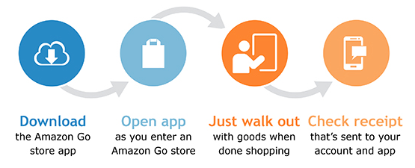
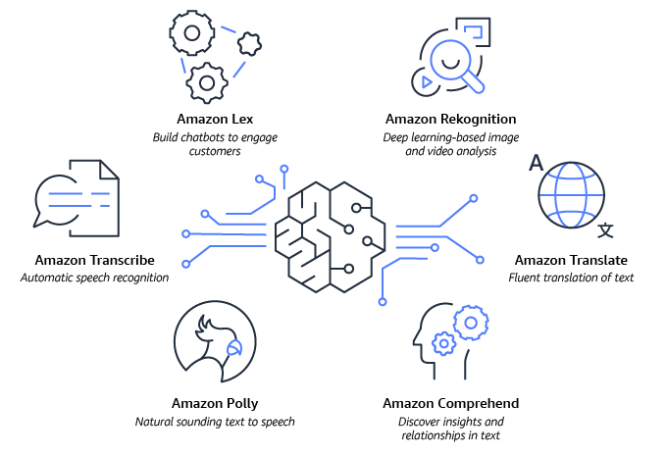
Amazon – Game Changer of the Decade

Slide 61
Machine Learning in Civil Engineering
Design of Construction Management System
Prediction of the Severity of Earthquakes
Better analysis of monitoring the construction health
Analysis of Environmental Engineering
Design of Highway and transportation Engineering fo the prediction of Transport arrivals and pedestrian movement analysis
Use of Machine learning in surveying, Geotechnical and Geospatial Engineering

Slide 62
Machine Learning in Mechanical Engineering
Cognitive Science of a Machine
Use of IoT and Big Data Analytics
On site performance of devices
Non-linear root cause analysis
Tools for analytics and operations

Slide 63
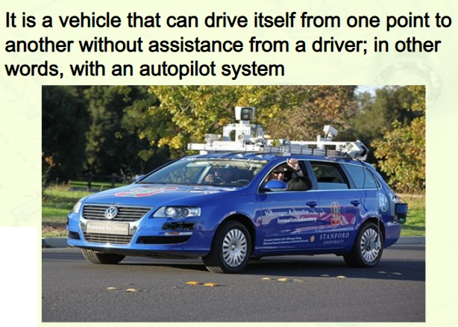
Autonomous Cars - ALVINN

Slide 64
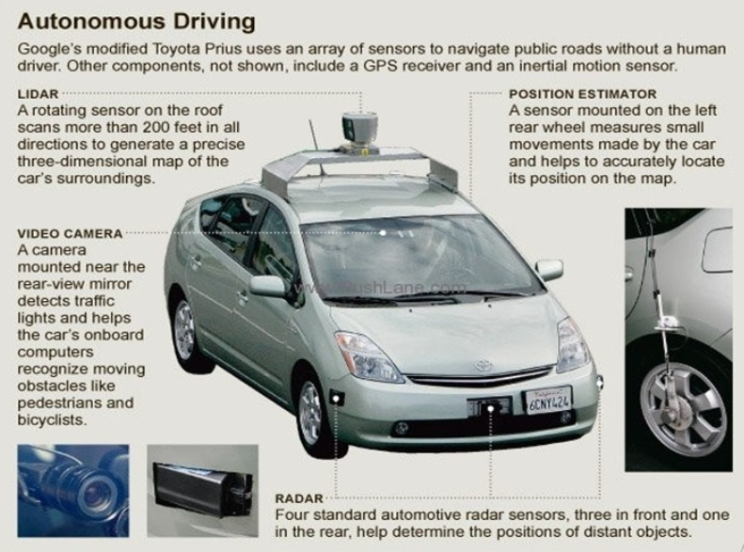
Autonomous Driving Cars

Slide 65
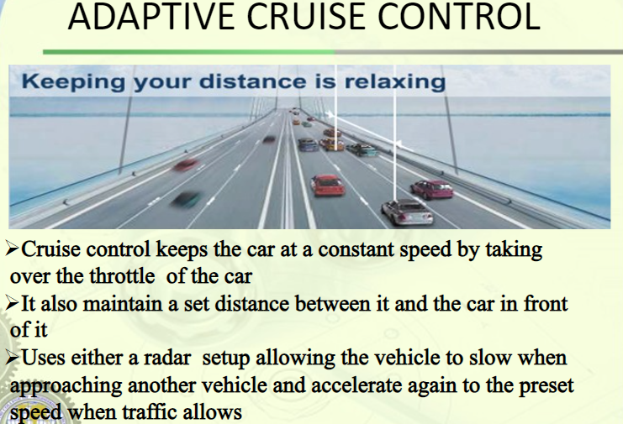

Slide 66
AI for automatically segmenting brain tumors
Artificial Intelligence has a broad scope in healthcare devices and applications.
Makes analysis, treatment, and monitoring of tumors more effective.
NVIDIA has developed a 3D MRI brain tumor segmentation using deep-learning and 3D magnetic resonance imaging technologies.

Slide 67
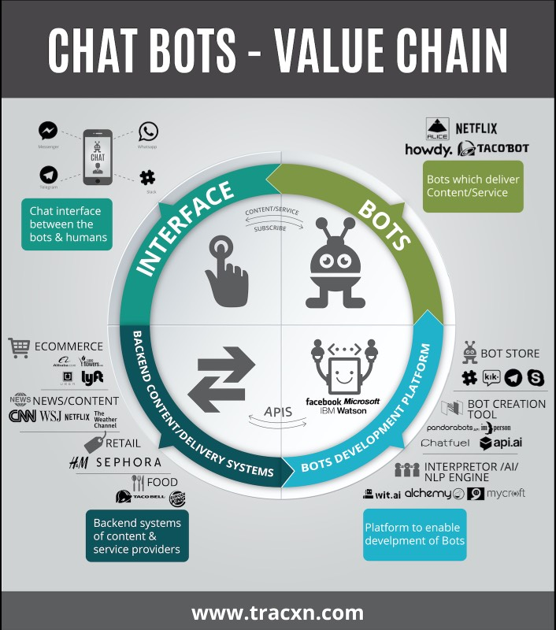
Chat bots

Slide 68
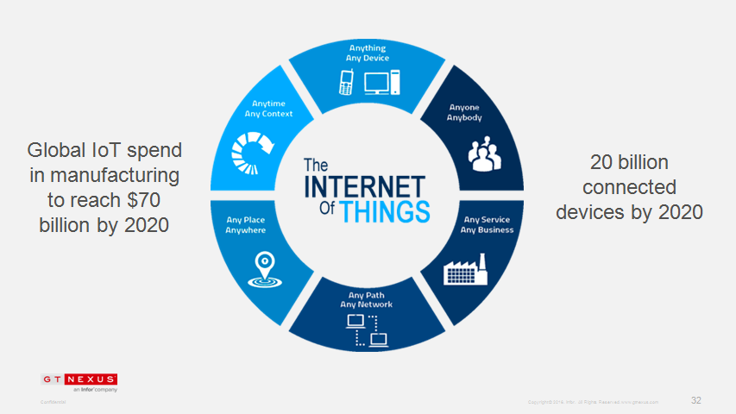
Internet of Things

Slide 69
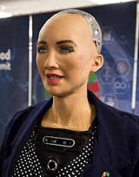

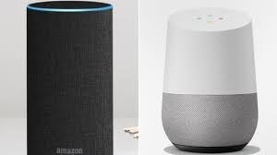
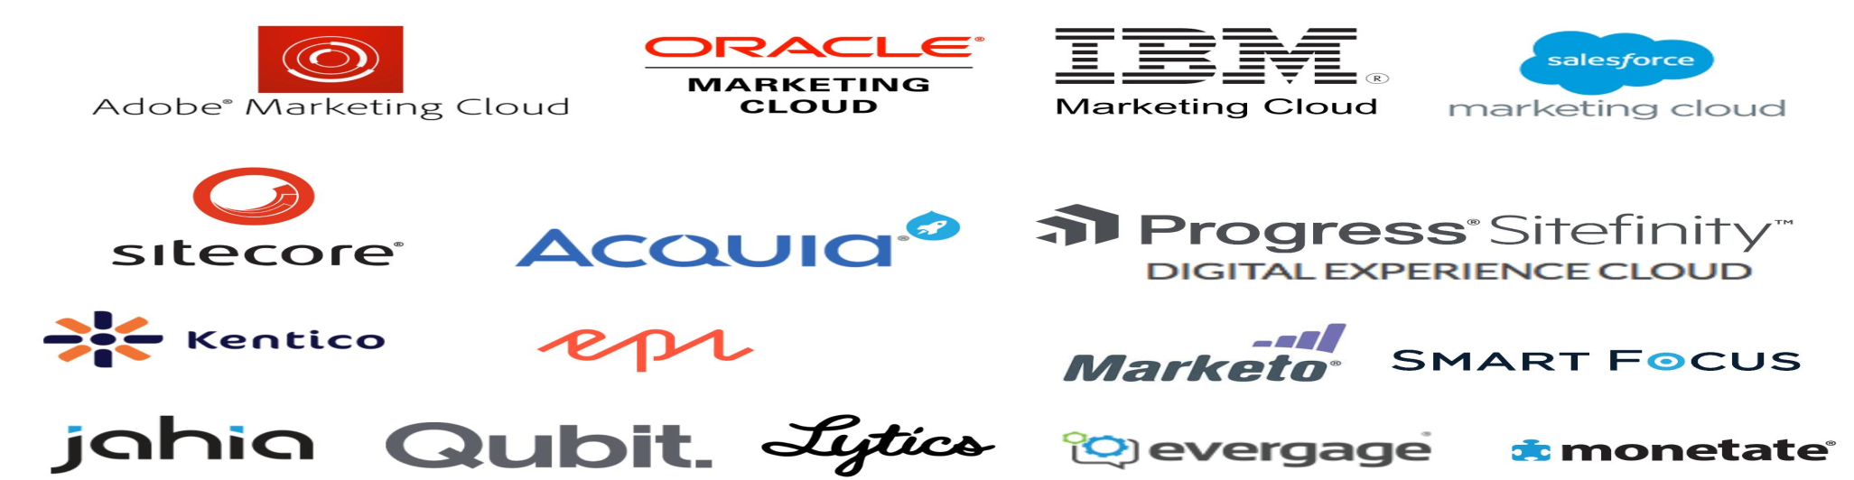
Personalization
Sophia
social humanoid
Google Assistant
Amazon Alexa
Virtual Assistant
Personalization Platforms

Slide 70

AI vs Machine Learning vs Deep Learning
Programs with the ability to learn and reason like humans
Algorithms with the ability to learn without being explicitly programmed
Subset of Machine Learning in which Artificial Neural Networks adapt and learn from vast amounts of data.

Slide 71
Future of machine learning
Improved unsupervised algorithms
Enhanced personalization
Increased adoption of quantum computing
Improved cognitive services
Rise of robots

Slide 72
Top Machine Learning Software Tools
Software | Platform | Written in language | Algorithms or Features
Scikit Learn | Linux, Mac OS, Windows | Python, Cython, C, C++ | Classification, Regression Clustering, Preprocessing Model Selection Dimensionality reduction.
PyTorch | Linux, Mac OS, Windows | Python, C++, CUDA | Autograd Module, Optim Module, nn Module
TensorFlow | Linux, Mac OS, Windows | Python, C++, CUDA | Provides a library for dataflow programming.
Weka Waikato Environment for Knowledge Analysis | Linux, Mac OS, Windows | Java | Data preparation, Classification Regression, Clustering Visualization, Association rules mining

Slide 73
Top Machine Learning Software Tools
Software | Platform | Written in language | Algorithms or Features
KNIME Konstanz Information Miner | Linux, Mac OS, Windows | Java | Can work with large data volume. Supports text mining & image mining through plugins
Colab | Cloud Service | - | Supports libraries of PyTorch, Keras, TensorFlow, and OpenCV
Apache Mahout | Cross-platform | Java Scala | Preprocessors, Regression Clustering, Recommenders Distributed Linear Algebra.
Accors.Net | Cross-platform | C# | Classification, Regression, Distribution, Clustering Hypothesis Tests & Kernel Methods, Image, Audio & Signal. & Vision

Slide 74
Top Machine Learning Software Tools
Software | Platform | Written in language | Algorithms or Features
Shogun | Windows Linux UNIX Mac OS | C++ | Regression, Classification Clustering, Support vector machines, Dimensionality reduction, Online learning etc.
Keras.io | Cross-platform | Python | API for neural networks , supports CNN
Rapid Miner | Cross-platform | Java | Data loading & Transformation Data preprocessing & visualization.
Oryx2 | Cross Platform | Python | collaborative filtering, classification, regression , DL, CNN

